Slide 1

NPS Quarterly
Summary

Slide 2
Objectives
Automates creation of comprehensive quarterly NPS summary across multiple regions for the current year
Creates dashboard that quickly summarizes relevant data into graphs
Methodology
NPS:
Reads input data from all countries
Processes, cleans and filters the data
Creates analytical quarterly summaries (pivot tables)
Exports the results to a single Excel file
Creates dashboard with graphs to show quarterly summaries
Limitations
NPS:
All countries excel files must be in same folder as program
Input excel files must be named:
SG: C2B Customer Satisfaction Survey (Responses).xlsx
MY: MY C2B Customer Satisfaction Survey (Responses).xlsx
TH: TH C2B Customer Satisfaction Survey (Responses).xlsx
Only shows data from the current year
No interactive dropdown filters in the excel sheet for the pivot tables (No GUI)
Any data responses with no name will be grouped under “No Name”

Slide 3
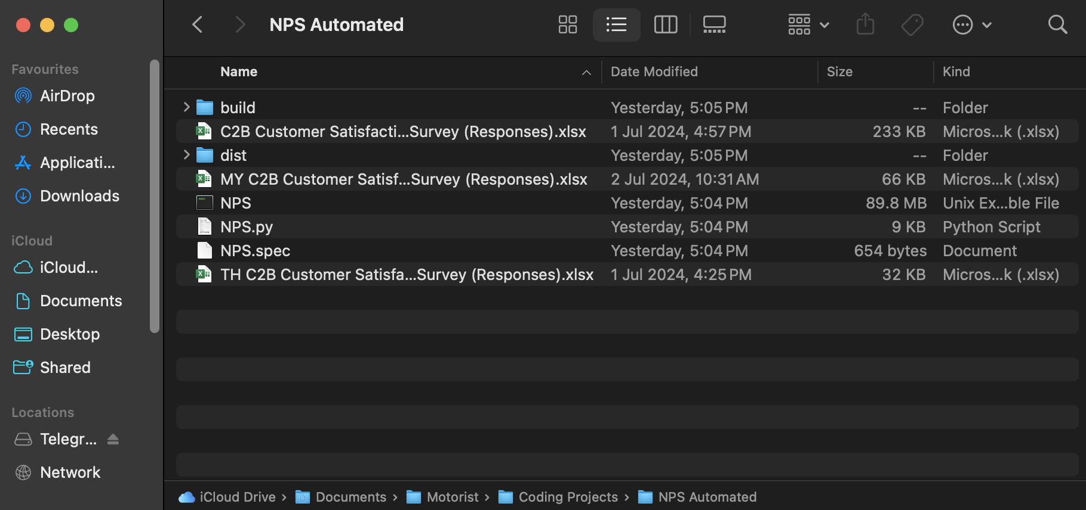
How to Use
Ensure all country excel files (Yellow) into same folder as the executable file (Red)

Slide 4
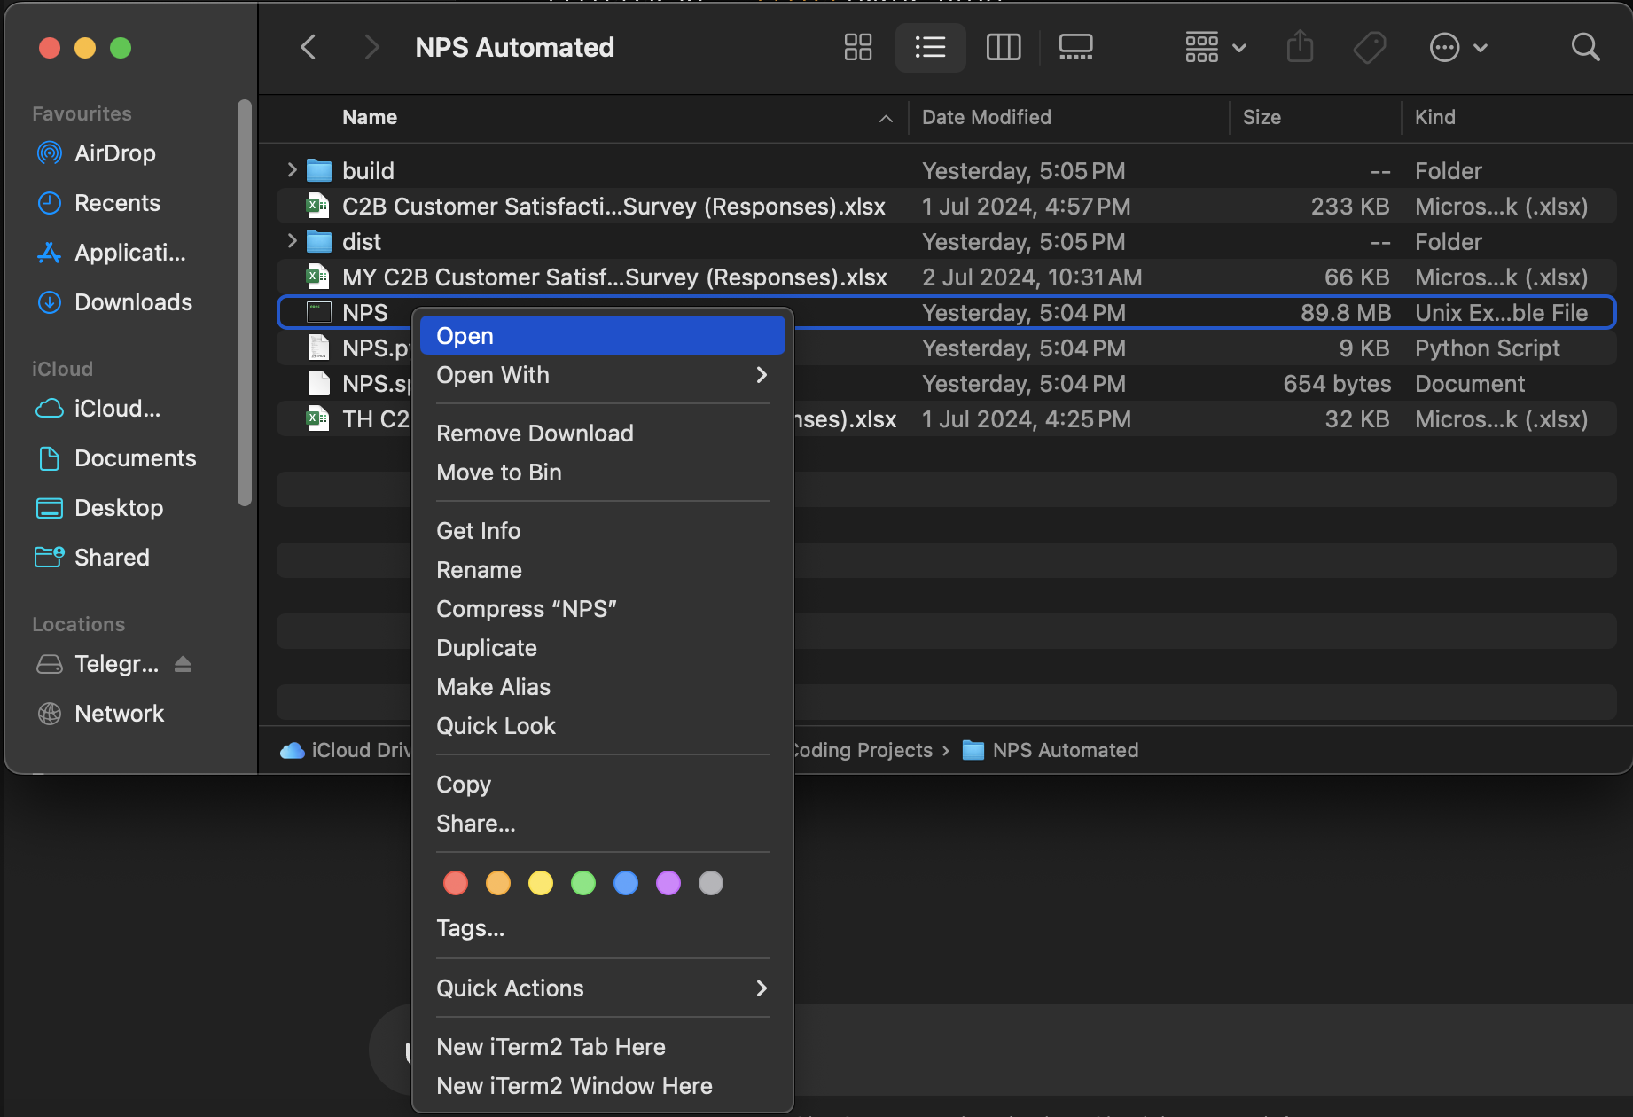
How to Use
Right click executable file and click ‘Open’

Slide 5
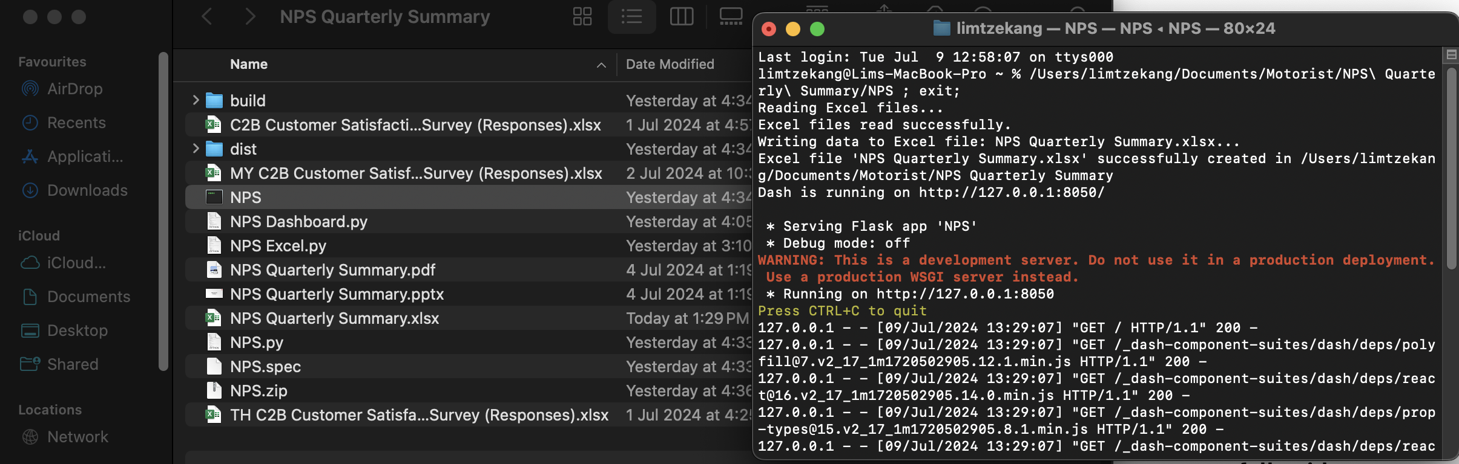
How to Use
NPS Quarterly Summary excel file created in same folder
Program executed successfully with no errors

Slide 6
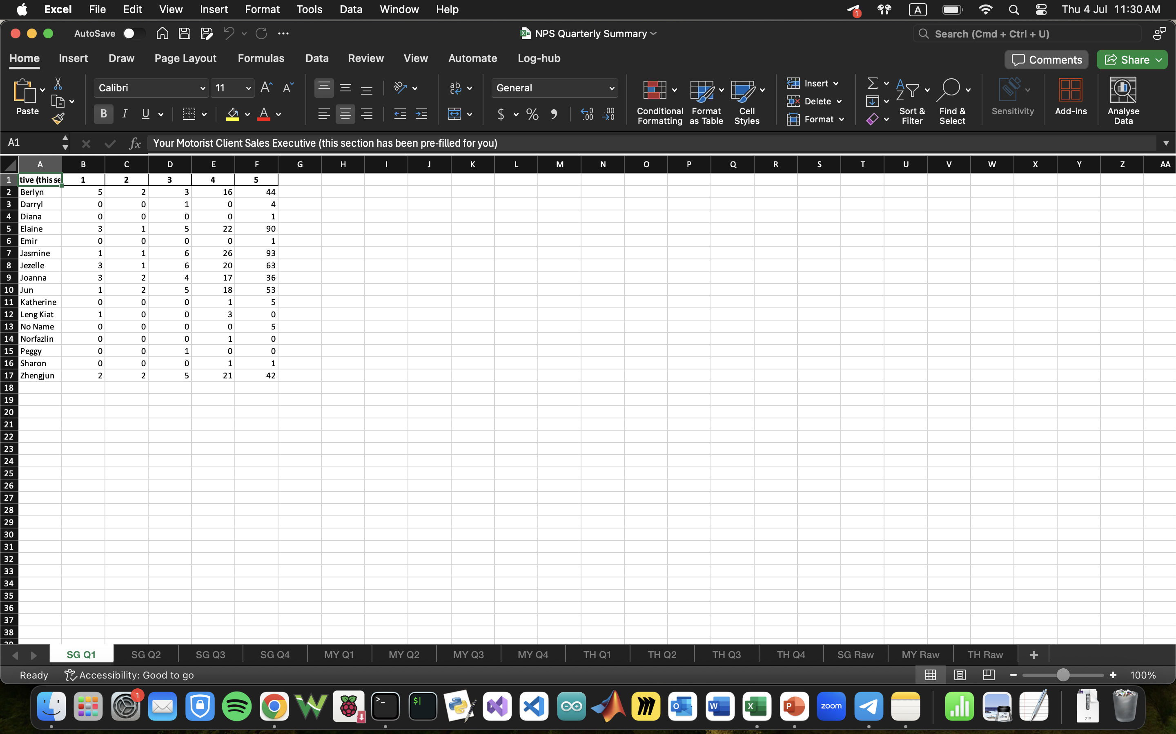
How to Use
How the excel file should look like =>
Every Country
has 5 sheets:
4 Quarterly sheets and 1 Raw Data sheet

Slide 7
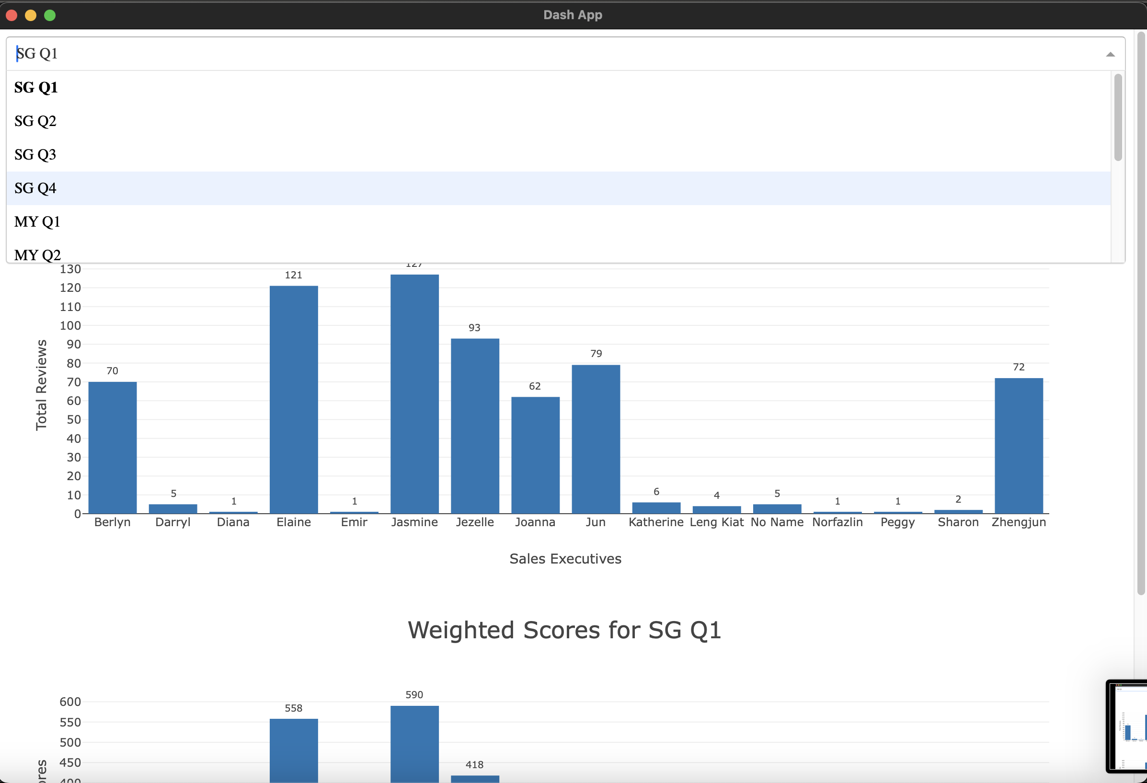
How to Use
How the dashboard should look like =>
Dropdown menu for each country and each quarter
Currently 2 bar graphs showing number of reviews and weighted review score for every sales executive
To close App, press command + Q in the app or control + C in the terminal

